Slide 1

Digital Image Processing with CUDA
By Abdoula Barry, CSYS
Advanced Computer Systems; Fall 2023

Slide 2
Overview
CUDA Introduction and Basics
Applications in Image Processing
Gaussian Blur
Results
Host vs Device Performance
Future Improvements and Additions
Lessons Learned

Slide 3
Compute unified device architecture (Cuda)
Introduced in November 2006 by NVIDIA
General Purpose Parallel Computing Platform
Hides GPU HW from developers
3 key abstractions
A hierarchy of thread groups
Shared Memories
Barrier Synchronization

Slide 4
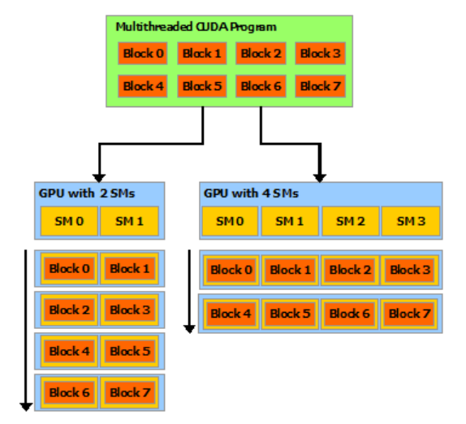
CUDA programming model
Work distributors forward stream to Streaming Processor Array
Streaming Multiprocessors execute parallel computing programs
Shared Memory holds shared data between Streaming Processors for thread communication

Slide 5
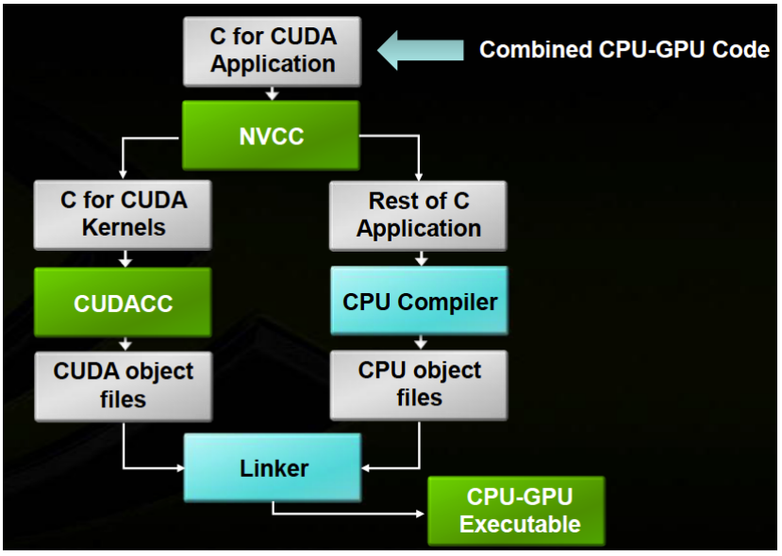
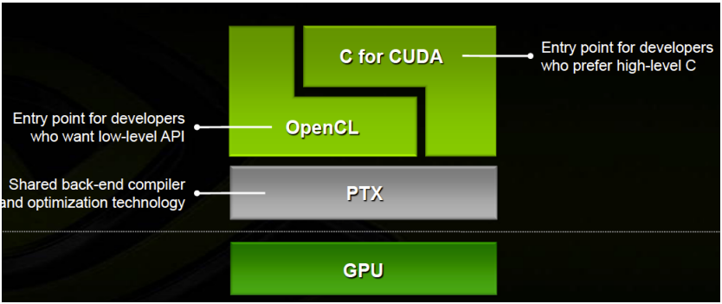
CUDA Programming model
Parses Source -> Creates 2 files : host and device
Host – CPU
Device – GPU
CUDA object files written in PTX, the CUDA instruction set architecture

Slide 6
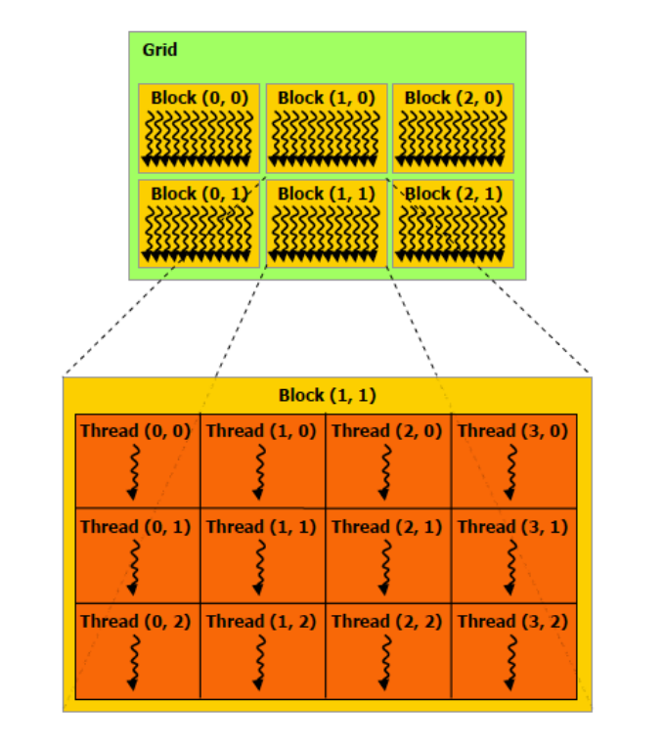
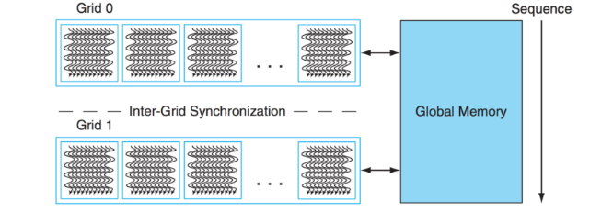
CUDA Programming model
Serial Code executes on host
Parallel Code on device

Slide 7
Applications in image processing
Image processing is a natural fit for parallel processing
Pixels mapped directly to threads
Each thread can write more than one pixel
Applications
Convolutions
Image & Video Compression
Noise Reduction
Histograms

Slide 8
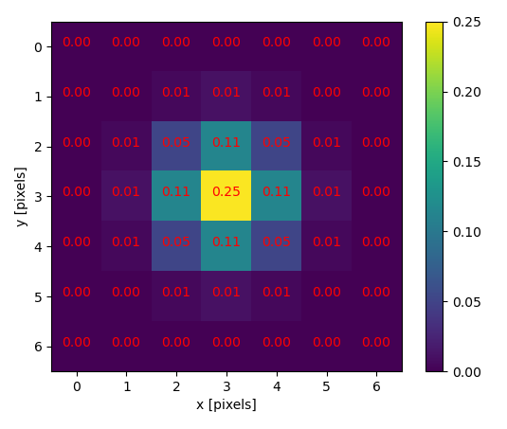
Gaussian blur
Image smoothing to reduce noise and detail
Low-pass filter
Reduces disparity between pixels by nearby ones
Less weight to pixels further from center of window

Slide 9
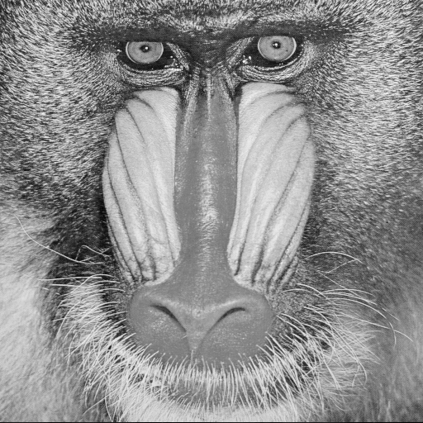
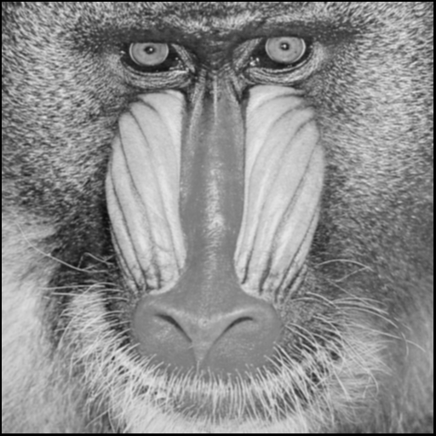
results
Original Image
Altered Image

Slide 10
Host vs device performance

Slide 11
Information learned and topics to explore
SIMT – Single Instruction Multiple Thread
-SIMT instruction unit subdivides threads into groups of 32 called warps
-Warp allows for thread scheduling in a Streaming Multiprocessor
SPMD – Single Program Multiple Data : widely used in parallel computing systems
-Asynchronous version of SIMD
Sobel Edge Detection
Explore Video Processing with CUDA
Object Recognition

Slide 12
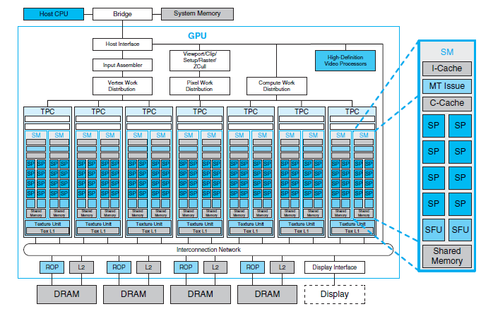
GPU Architecture

